Slide 1
Negotiation result: PRIVATE SOCIAL SERVICES SECTOR’S collective agreement 8 June 2023
JHL’s Union Council/Executive Committee 12 June 2023 /Tanja Tuunainen-Vainio and Hanna Katajamäki

Slide 2
Agreement period
The agreement period is 32 months
The collective agreement entered into force on 1 May 2023 and will expire on 31 December 2025

Slide 3
Pay raises
2023
On 1 September 2023, a general raise and scale raise of 3.6%
1 September 2023 The minimum salary scales will be increased in all six competence requirement groups
The minimum salary scales will be increased in all service increment steps
        Pay groups A-B 1.9%
        Pay groups C-F 2.2%.
On average, the cost impact of the minimum raise increasing the pay level of the industry is 1.56%.

Slide 4
Pay raises - one-time instalment - early childhood education and care
2024
May
Early childhood education and care employees will be paid a one-time EUR 470 “retention instalment” in May 2024 in connection to their regular pay day.
The prerequisites for paying the one-time instalment are that the employee’s consecutive employment relationship has started no later than on 1 February 2024, they are in an employment relationship and within the salary payment system at the time of paying.
The one-time instalment will not be paid if an employee has terminated their employment relationship before the instalment is paid, unless it is a question of retiring.
If the other terms and conditions are fulfilled, the one-time instalment is paid to those on family leave regardless of whether they are within the salary payment system.
If the other terms and conditions are fulfilled, the one-time instalment is paid during an absence due to illness regardless of whether the employee is within the salary payment system, with the prerequisite that the absence due to illness has started after 1 February 2024.
If the other terms and conditions are fulfilled, the amount paid to a part-time employee is calculated in relation to the agreed working time and full working time in accordance with the collective agreement valid on 2 May 2024. For employees with varying working time arrangements, the one-time instalment will be paid according to the realised working time (review period 6 months or, if the employment relationship is shorter than that, the entire length of employment).
When reviewing the consecutiveness of an employment relationship, short interruptions in accordance with chapter 1, section 5 of the Employment Contracts Act are taken into account.

Slide 5
Pay raises - one-time instalment
2024
June
In industries covered by the collective agreement (other than early childhood education and care), a one-time instalment of EUR 470 will be paid to employees in June 2024 in connection to the regular pay day. The prerequisites for paying the one-time instalment are that the employee’s consecutive employment relationship has started no later than on 1 March 2024, they are in an employment relationship and being paid a wage at the time of paying.
The one-time instalment will not be paid if an employee has terminated their employment relationship before the instalment is paid, unless it is a question of retiring.
If the other terms and conditions are fulfilled, the one-time instalment is paid to those on family leave regardless of whether they are being paid a wage.
If the other terms and conditions are fulfilled, the one-time instalment is paid during an absence due to illness regardless of whether the employee is being paid a wage, with the prerequisite that the absence due to illness has started after 1 March 2024.
If the other terms and conditions are fulfilled, the amount paid to a part-time employee is calculated in relation to the agreed working time and full working time in accordance with the collective agreement valid on 3 June 2024.
For employees with varying working time arrangements, the one-time instalment will be paid according to the realised working time (review period 6 months or, if the employment relationship is shorter than that, the entire length of employment).
When reviewing the consecutiveness of an employment relationship, short interruptions in accordance with chapter 1, section 5 of the Employment Contracts Act are taken into account.
The cost effect of the one-time instalments in May and June 2024 is 1.3%.

Slide 6
Pay raises
2024
On 1 August 2024, a general raise and scale raise of 2.4%
On 1 August 2024, the minimum salary scales will be increased in all six competence requirement groups.
        The minimum salary scales will be increased in all service increment steps
        Pay groups A-B 1.6%
        Pay groups C-F 1.8%.
On average, the cost impact of the minimum raise increasing the pay level of the industry is 1.47%.

Slide 7
Pay raises - one-time instalment - early childhood education and care
2025
May
Early childhood education and care employees will be paid a one-time EUR 150 “retention instalment” in May 2025 in connection to their regular pay day. The instalment is paid with the same prerequisites as the May 2024 one-time instalment in early childhood education and care, with 2025 dates.

Slide 8
Pay raises
2025
On 1 August 2025, a general raise and scale raise of 1.0%
1 August 2025 The minimum salary scales will be increased in all six competence requirement groups.
  The minimum salary scales will be increased in all service increment steps
  Pay groups A-B 1% and
  pay groups C-F 1.2%.
On average, the cost impact of the minimum raise increasing the pay level of the industry is 1.04%

Slide 9
Pay raises - local instalment
2025
1 August 2025
- In industries covered by the collective agreement (other than early childhood education and care), a local “attraction instalment for wellbeing services counties” of 0.7% will be allocated in accordance with local instalment allocation instructions (see the separate appendix, in Finnish).
- Employer fallback clause
- In case this has not been negotiated and allocated by 1 October, it will be paid as a general retroactive raise to all employees as of 1 August.

Slide 10
Application instruction - availability supplement or a corresponding supplement
Retaining the availability supplement or a corresponding supplement in connection to the collective agreement’s minimum raises
The parties regard it as important that, in addition to safeguard the sector's ability to attract new employees and hold on to the old ones, employers can grant pay raises that exceeds the minimum obligations in the collective agreement, for instance through availability supplements or the like.
The parties do not want to use the collective agreement to prevent the realisation of availability supplements in accordance with their original purpose and content.
Thus, when it comes to availability supplements in connection to minimum raises, one will act according to what has been agreed or expressed on the fixed-term nature or possible decrease of availability supplements when the availability supplement has been granted.
In case it has been agreed that the availability supplement, or a corresponding supplement, will expire or diminish in connection to minimum raises or in other situations where salaries increase more than the general raise, the employer can, after consideration, decrease the availability supplement in connection to the minimum raise, at most by the amount of the minimum raise.

Slide 11
Costs
Altogether, the cumulative impact of this pay raise solution under the agreement period of 2 years 8 months will be 13.52% in the social services industry. In early childhood education and care, the cumulative pay raise impact is 13.17%.
The combined non-cumulative raise impact is 13.07% in the social services industry and 12.78% in early childhood education and care.

Slide 12
Costs, increase as of 1 September 2023
compensation for shop stewards, chief shop stewards and occupational safety and health representatives – increase of 13%
compensation for urgent work – increase of 13%
language proficiency bonus – increase of 13%

Slide 13
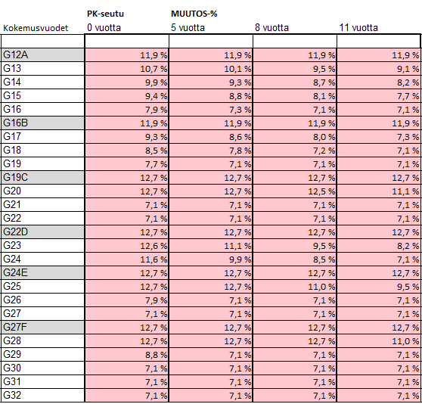
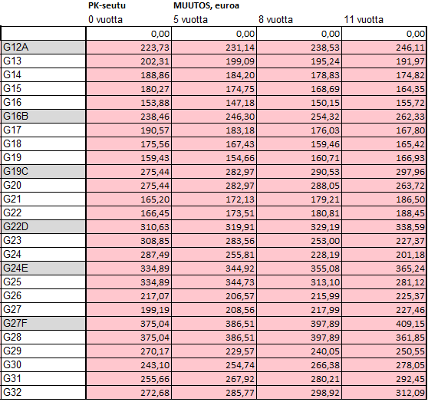
Change during the agreement period - Helsinki Metropolitan Region

Slide 14
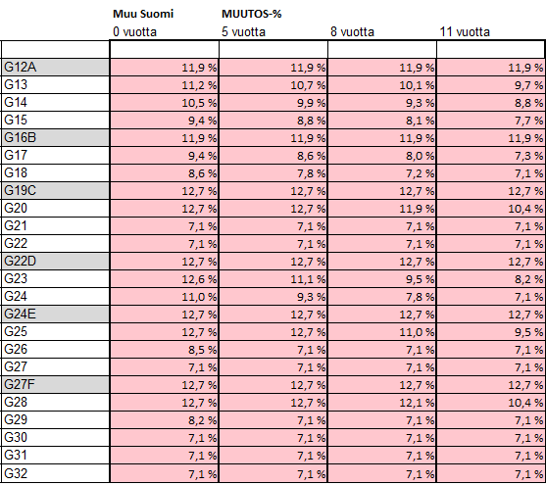
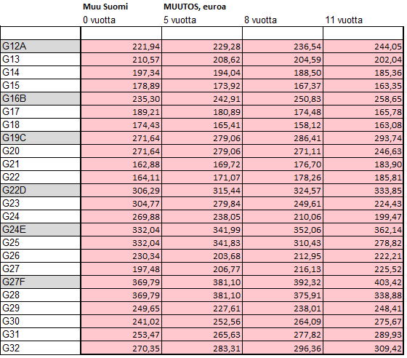
Change during the agreement period - rest of Finland

Slide 15
Textual changes
Use of the shift roster
The entry will remain the same, but application instructions will be added:
Application instruction 1:
When it is agreed on an extra shift or increasing the length of a shift with a full-time employee, it is a question of overtime work if the overtime work limits of the collective agreement are exceeded. If, moreover, it is agreed in consultation with the employee on how the corresponding shortening of working time is realised during the adjustment period, it has to do with a change in the shift roster.
(Flexible working time and flexiwork have their own principles that correspond to the Working Time Act of realising the changes)
Application instruction 2:
A shift change unilaterally executed by the employer in a weighty, unforeseeable change situation cannot apply to a shift that has already started.

Slide 16
Textual changes
Annual holiday
This text will remain the same: ”Without agreement, a four-week summer holiday or one-week winter holiday can be split into several parts in accordance with this application instruction only in very exceptional situations where service provision cannot be guaranteed by using substitutes or by taking other action.”
An application instruction will be added:
In addition, splitting holidays without agreement requires that the possible very exceptional need to split holidays, and the justifications for it, have been processed in advance with the shop steward and each employee or, if the workplace lacks a shop steward, together with the employees and each employee.
Furthermore, one must consider the principles mentioned in section 3 on listening to employee requests, taking them into account whenever possible, and equity when allocating holidays.

Slide 17
Textual changes
Local agreement practices
In case some signatory organisation has a shop steward, the employees belonging to other signatory organisations can authorise this shop steward to also represent themselves. Alternatively, they can elect a representative/representatives amongst themselves.
At the beginning of the negotiations, it is stated who the negotiators are and which parties they represent.

Slide 18
Textual changes
Pay agreement
Pay agreement section 5 (Part-time employees) has been removed
Protocol entry:
The raised part-time monthly pay of an employee covered by the previous collective agreement who has worked less than 19 hours a week on average cannot decrease in the previous part-time work, although the provision in question has been removed from the collective agreement.

Slide 19
Agreement period’s project, and working groups
1. Private social services sector’s development project related to attraction and retention (see the protocol of signature, in Finnish)
2. Renewal of the guide on healthy and productive working time (“Terveet ja tulokselliset työajat”) (the current group will continue)
3. Working groups related to well-being at work
A) The current working group will continue its work and report to the parties’ attraction and retention project
B) In addition to the previous ones, a new theme has to do with looking into whether trips between customers can be marked in the shift roster in work that involves switching among workstations, and how the trips can be taken into account in shift planning
4. Working group looking into protective clothing mentioned in section 25 of the collective agreement (the current working group will continue)
5. Working group looking into the possibility of clarifying the percentage scales of annual holiday pay in section 18, subsection 8 in a cost neutral way, and looking into the application schedule of the possible change

